Slide 1
Data Mining:
Concepts and Techniques
— Unit IV —
Mining Frequent Patterns, Association Rules and Correlations

Slide 2

Mining Frequent Patterns, Association and Correlations
Association rule mining
Mining single-dimensional Boolean association rules from transactional databases
Mining multilevel association rules from transactional databases
Summary

Slide 3
Mining Frequent, Associations and Correlations:
Basic concepts,
Frequent Item set mining methods,
Mining multilevel association rules from Transaction Databases,
Mining Multidimensional association rules from Relational databases and Data Warehouses,
From Association Mining to Correlation Analysis,
Constraint-Based Association Mining.

Slide 4
What Is Association Mining?
Association rule mining:
  Finding frequent patterns, associations, correlations, or causal structures among sets of items or objects in transaction databases, relational databases, and other information repositories.
Applications:
  Basket data analysis, cross-marketing, catalog design, loss-leader analysis, clustering, classification, etc.
Examples.
  Rule form: “Body → Ηead [support, confidence]”.
  buys(x, “milk”) → buys(x, “bread”) [0.5%, 60%]
  major(x, “CS”) Λ takes(x, “DB”) → grade(x, “A”) [1%, 75%]

Slide 5
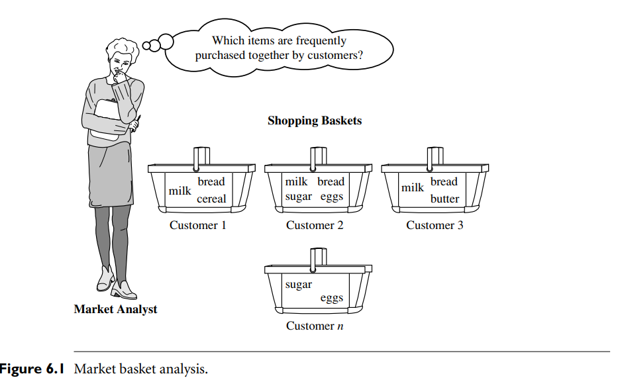

Slide 6
Rule Measures: Support and Confidence
Rule support and confidence are two measures of rule interestingness. They respectively reflect the usefulness and certainty of discovered rules.
Ex: computer ⇒ antivirus software [support = 2%,confidence = 60%].
A support of 2% for Rule (6.1) means that 2% of all the transactions under analysis show that computer and antivirus software are purchased together. A confidence of 60% means that 60% of the customers who purchased a computer also bought the software.
Typically, association rules are considered interesting if they satisfy both a minimum support threshold and a minimum confidence threshold.
These thresholds can be a set by users or domain experts.

Slide 7
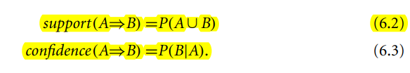
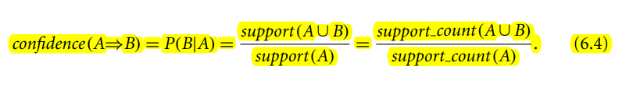
Rules that satisfy both a minimum support threshold (min sup) and a minimum confidence threshold (min conf ) are called strong

Slide 8
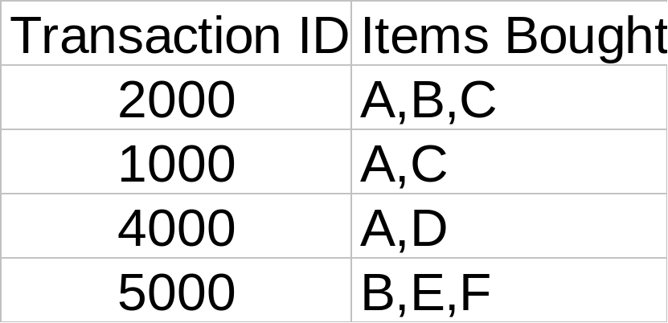
Rule Measures: Support and Confidence
Customer
buys both
Customer
buys bread
Find all the rules X & Y ⇒ Z with minimum confidence and support
  support, s, probability that a transaction contains {X U Y U Z}
  confidence, c, conditional probability that a transaction having {X U Y} also contains Z
Customer
buys milk
Let minimum support 50%, and minimum confidence 50%, we have
  A ⇒ C (50%, 66.6%)
  C ⇒ A (50%, 100%)

Slide 9
What Is Frequent Pattern Analysis?
Frequent pattern: a pattern (a set of items, subsequences, substructures, etc.) that occurs frequently in a data set.
First proposed by Agrawal, Imielinski, and Swami in the context of frequent itemsets and association rule mining.
Motivation: Finding inherent regularities in data
  What products were often purchased together?— PC and Coke ?!
  What are the subsequent purchases after buying a PC?

Slide 10
For example, a set of items, such as milk and bread, that appear frequently together in a transaction data set is a frequent itemset.
A subsequence, such as buying first a PC, then a digital camera, and then a memory card, if it occurs frequently in a shopping history database, is a (frequent) sequential pattern.
A substructursubgraphs, subtrees, or sublatticese can refer to different structural forms, such as, which may be combined with itemsets or subsequences.
If a substructure occurs frequently, it is called a (frequent) structured pattern.
Finding frequent patterns plays an essential role in mining associations, correlations, and many other interesting relationships among data.

Slide 11
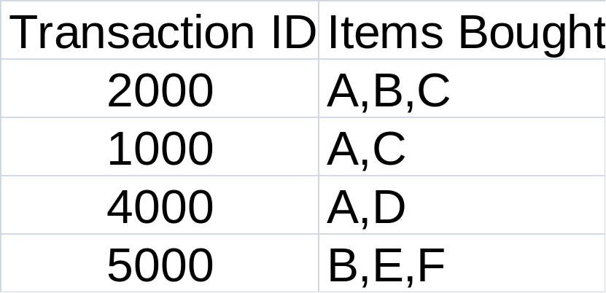
Let I = {I1, I2,..., Im} be an itemset.
D, the task-relevant data, be a set of
database transactions where each
transaction T is a nonempty itemset such that T ⊆ IU
Each transaction is associated with an identifier, called a TID
A set of items is referred to as an itemset.
An itemset that contains k items is a k-itemset.
The set {computer, antivirus software} is a 2-itemset.
Frequency, support count, or count of the itemset: number of transactions that contain the itemset.

Slide 12
Frequent itemset: absolute support of I satisfies the corresponding minimum support count threshold
Let minimum support 50%,
and minimum confidence 50%,
we have
  A ⇒ C (50%, 66.6%)
  C ⇒ A (50%, 100%)
Itemset ex: Frequent Itemset
AC support is 2 (50%) >=min support50% yes
AD support is 1(25%)
ABC support is ?

Slide 13
Association rule mining steps
How are association rules mined from large databases?" Its a two-step process:
Step 1: Find all frequent itemsets. By definition, each of these itemsets will occur at least as frequently as a pre-determined minimum support count.
Step 2: Generate strong association rules from the frequent itemsets. By definition, these rules must satisfy minimum support and minimum confidence.

Slide 14
Association Rule Mining: A Road Map
Association rules can be classified in various ways, based on the following criteria:
Based on the types of values handled in the rule
  Boolean vs. quantitative associations
2. Based on the dimensions of data involved in the rule
  Single dimension vs. multiple dimensional associations
3. Based on the levels of abstractions involved in the rule set
  Single level vs. multiple-level analysis
4. Based on the nature of the association involved in the rule
  Various extensions- Correlation analysis, Max Patterns generation, Frequent Itemset Counting

Slide 15
Boolean vs. quantitative associations (Based on the types of values handled)
  buys(x, “SQLServer”) Λ buys(x, “DMBook”) → buys(x, “DBMiner”) [0.2%, 60%]
  age(x, “30..39”) Λ income(x, “42..48K”) → buys(x, “Macbook”) [1%, 75%]
Single dimension vs. multiple dimensional associations (see ex. Above)
Single level vs. multiple-level analysis
  What brands of beers are associated with what brands of noodles?
Various extensions
  Correlation, causality analysis
    Association does not necessarily imply correlation or causality
  Maxpatterns and closed itemsets
  Constraints enforced
    E.g., small sales (sum < 100) trigger big buys (sum > 1,000)?

Slide 16
Mining Frequent Patterns, Association and Correlations
Association rule mining
Mining single-dimensional Boolean association rules from transactional databases
Mining multilevel association rules from transactional databases
Summary

Slide 17
Scalable Methods for Mining Frequent Patterns
The downward closure property of frequent patterns
  Any subset of a frequent itemset must be frequent
  If {Coke, Bread, Nuts} is frequent, so is {Coke, Bread}
  i.e., every transaction having {Coke, Bread, Nuts} also contains {Coke, Bread}
Scalable mining methods: Three major approaches
  Apriori
  Freq. Pattern growth
  Vertical data format approach

Slide 18
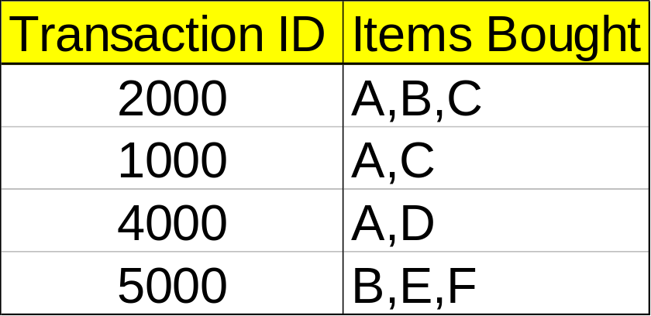
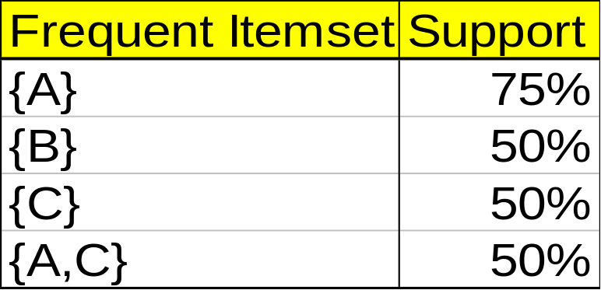
Mining Association Rules—An Example
Min. support 50%
Min. confidence 50%
For rule A ⇒ C:
  support = support({A U C}) = 50%
  confidence = support({A U C})/support({A}) = 66.6%
The Apriori principle:
  Any subset of a frequent itemset must be frequent

Slide 19
Apriori Algorithm
The Apriori principle:
  Any subset of a frequent itemset must be frequent
  Apriori property: All nonempty subsets of a frequent itemset must also be frequent.
  or
Antimonotonicity in the sense that if a set cannot pass a test, all of its supersets will fail the same test as well.

Slide 20
Apriori Algorithm
Mining Frequent Itemsets: the Key Step
Find the frequent itemsets: the sets of items that have minimum support
  A subset of a frequent itemset must also be a frequent itemset
    i.e., if {AB} is a frequent itemset, both {A} and {B} should be a frequent itemset
  Iteratively find frequent itemsets with cardinality from 1 to k (k-itemset)
Use the frequent itemsets to generate association rules.

Slide 21
The Apriori Algorithm—An Example
Sup_{min} = 2
Itemset | sup
{A} | 2
{B} | 3
{C} | 3
{D} | 1
{E} | 3
Database TDB
Itemset | sup
{A} | 2
{B} | 3
{C} | 3
{E} | 3
L₁
Tid | Items
10 | A, C, D
20 | B, C, E
30 | A, B, C, E
40 | B, E
C₁
1st scan
C₂
Itemset | sup
{A, B} | 1
{A, C} | 2
{A, E} | 1
{B, C} | 2
{B, E} | 3
{C, E} | 2
C₂
L₂
Itemset
{A, B}
{A, C}
{A, E}
{B, C}
{B, E}
{C, E}
Itemset | sup
{A, C} | 2
{B, C} | 2
{B, E} | 3
{C, E} | 2
2nd scan
C₃
Itemset
{B, C, E}
3rd scan
L₃
Itemset | sup
{B, C, E} | 2

Slide 22
The Apriori Algorithm
Join Step: C_{k} is generated by joining L_{k-1}with itself
Prune Step: Any (k-1)-itemset that is not frequent cannot be a subset of a frequent k-itemset
Pseudo-code:
    C_{k}: Candidate itemset of size k
    L_{k} : frequent itemset of size k
    L₁ = {frequent items};
    for (k = 1; L_{k} !=∅; k++) do begin
    C_{k+1} = candidates generated from L_{k};
    for each transaction t in database do
      increment the count of all candidates in C_{k+1} that are contained in t
    L_{k+1} = candidates in C_{k+1} with min_support
    end
    return ∪_{k} L_{k};

Slide 23
Algorithm Apriori (in Detail)
Find frequent itemsets using an iterative level-wise approach.
Input: Database, D, of transactions; minimum support threshold, min sup.
Output: L, frequent itemsets in D. ( L is after pruning wrt min_sup)
Method:
  L₁ = find_frequent_1-itemsets(D);
  for (k = 2; L_{k-1}≠Φ; k++) {
    C_{k} = apriori_gen(L_{k-1}, min_sup);
    for each transaction t Є D { //scan D for counts
      C_{t} = subset (C_{k}, t); //get subsets of t that are candidates
      for each candidate c Є C_{t}
        c.count++;
      }
  L_{k} = {c Є C_{k} | c.count ≥ min_sup}
  }
  return L= U_{k} L_{k}

Slide 24
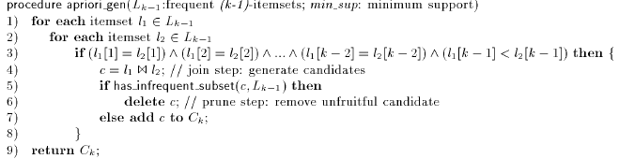

Procedures: apriori_gen and has_infrequent_subset

Slide 25
Generating association rules from frequent itemsets
Generating association rules from frequent itemsets is straight-forward.
Strong association rules satisfy both minimum support and minimum confidence
confidence(A=>B) = Prob(B/A) =support(AU B)/support(A)
Based on this equation, association rules can be generated as follows.
For each frequent itemset, l, generate all non-empty subsets of l. (Ex {B,C,E} – {B},{C},{E},{B,C}, {C,E},{B,E},{B,C,E}
For every non-empty subset s, of l, output the rule
s => (l-s) if support (l) / support(s) >= min_conf.
  where min conf is the minimum confidence threshold.

Slide 26
Suppose the data contains the frequent itemset l = {B,C,E}. The association rules that can be generated from l:
The non-empty subsets of l are {B,C}, {B,E}, {C,E}, {B}, {C}, and {E}.
The resulting association rules are as shown below, each listed with its confidence.
  B Λ C => E, confidence = 2/2 = 100%
  B Λ E => C, confidence = 2/3 = 67%
  C Λ E => B, confidence = 2/2 = 100%
  B => C Λ E, confidence = 2/3 = 67%
  C => B Λ E, confidence = 2/3 = 67%
  E => B Λ C, confidence = 2/3 = 67%
If the minimum confidence threshold is, say, 70%, then only the first and third rules above are output, since these are the only ones generated that are strong.
Tid | Items
10 | A, C, D
20 | B, C, E
30 | A, B, C, E
40 | B, E

Slide 27
Further Improvement of the Apriori Method
Major computational challenges
  Multiple scans of transaction database
  Huge number of candidates
  Tedious workload of support counting for candidates
Improving Apriori: general ideas
  Reduce passes of transaction database scans
  Shrink number of candidates
  Facilitate support counting of candidates

Slide 28
Methods to Improve Apriori’s Efficiency
Also called Variations of the Apriori algorithm
Hash-based itemset counting: A k-itemset whose corresponding hashing bucket count is below the threshold cannot be frequent
Transaction reduction: A transaction that does not contain any frequent k-itemset is useless in subsequent scans
Partitioning: Any itemset that is potentially frequent in DB must be frequent in at least one of the partitions of DB
Sampling: mining on a subset of given data, lower support threshold + a method to determine the completeness
Dynamic itemset counting: add new candidate itemsets only when all of their subsets are estimated to be frequent

Slide 29
Hash-based technique
The basic idea in hash coding is to determine the address of the stored item as some simple arithmetic function content
Map onto a subspace of allocated addresses using a hash function
Assume the allocated address range from b to n+b-1, the hashing function may take h=(a mod n)+b
In order to create a good pseudorandom number, n ought to be prime

Slide 30
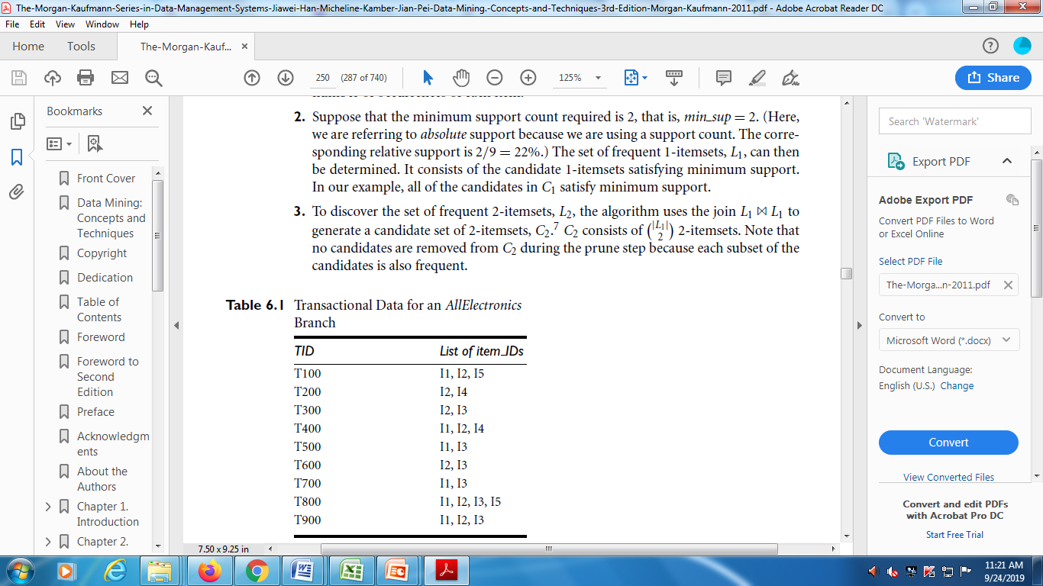
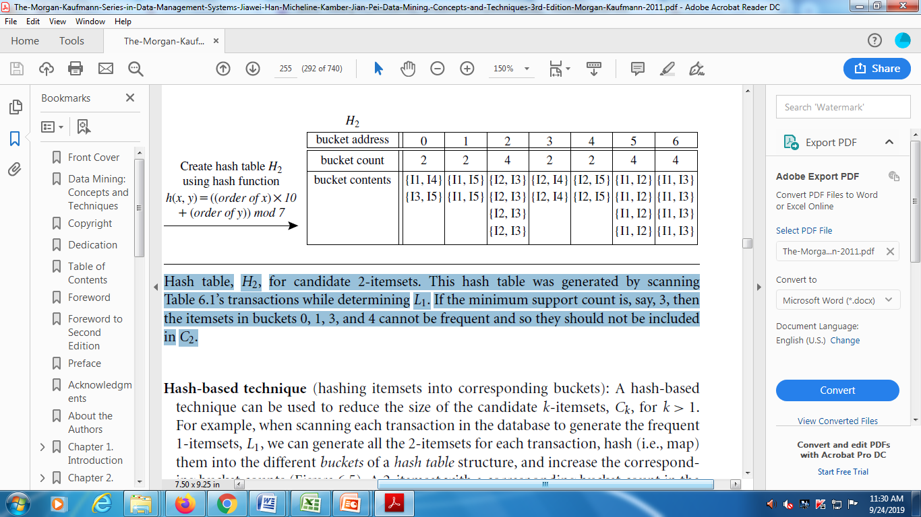
Transactional DB→
Hash based Itemset Counting
Hash table with hash function
h(x, y)=((order of x)10 +
(order of y)) mod 7
Hash table, H2, for candidate 2-itemsets. This hash table was generated by scanning transactions while determining L1. If the minimum support count is, say, 3, then the itemsets in buckets 0, 1, 3, and 4 cannot be frequent and so they should not be included in C2.

Slide 31
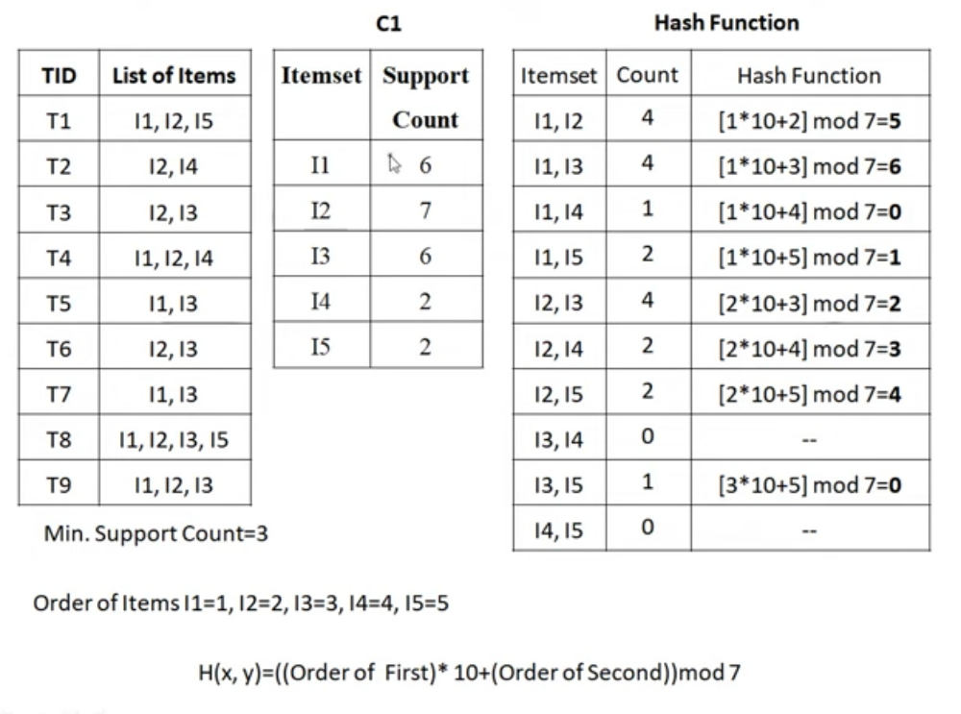

Slide 32
Hash-based technique (contd.)
Two different keywords may have equal hash addresses.
Partition the memory into buckets, and to address each bucket
  One address is mapped into one bucket
When scanning each transition in the database to generate frequent 1-itemsets, we can generate all the 2-itemsets for each transition and hash them into different buckets of the hash table.
We use h=a mod n, a address, n < the size of C_{2.}
A 2-itemset whose bucket count in the hash table is below the support threshold cannot be frequent, and should be removed from the candidate set

Slide 33
Transaction reduction
A transaction which does not contain frequent k-itemsets should be removed from the database for further scans

Slide 34
Partitioning
  First scan:
    Subdivide the transactions of database D into n non overlapping partitions
    If the minimum support in D is min_sup, then the minimum support for a partition is min_sup * number of transactions in that partition
    Local frequent items are determined
    A local frequent item my not be a frequent item in D
  Second scan:
    Frequent items are determined from the local frequent items

Slide 35
Sampling
Pick a random sample S of D
Search for local frequent items in S
  Use a lower support threshold
  Determine frequent items from the local frequent items
  Frequent items of D may be missed
For completeness a second scan is done

Slide 36
Dynamic Itemset Counting:
Reduce Number of Scans
adding candidate itemsets at different points during a scan.
Database is partitioned into blocks marked by start points
new candidate itemsets can be added at any start point, unlike in Apriori,
The technique uses the count-so-far as the lower bound of the actual count. If the count-so-far >= min_sup, the itemset is added into the frequent itemset collection

Slide 37
Bottlenecks of Apriori Algorithm
Apriori candidate generate-and-test method significantly reduces the size of candidate sets, leading to good performance gain.
However, it can suffer from two nontrivial costs:
It may need to generate a huge number of candidate sets. : Multiple database scans are costly.
  To find frequent itemset i₁i₂…i₁₀₀
    # of scans: 100
    # of Candidates: (₁₀₀¹) + (₁₀₀²) + … + (₁₀₀ ¹⁰⁰) = 2¹⁰⁰-1 = 1.27*10³⁰ !
Mining long patterns needs many passes of scanning and generates lots of candidates

Slide 38
Mining Frequent Patterns
Without Candidate Generation
Mines the complete set of frequent itemsets without candidate generation.
Frequent-pattern growth (or FP-growth):- adopts a divide-and-conquer strategy.
First, it compresses the database representing frequent items into a frequent-pattern tree (FP-tree).

Slide 39
Pattern-Growth Approach: Mining Frequent Patterns Without Candidate Generation
Bottlenecks of the Apriori approach
  Breadth-first (i.e., level-wise) search
  Candidate generation and test
    Often generates a huge number of candidates
The FPGrowth Approach (J. Han, J. Pei, and Y. Yin, SIGMOD’ 00)
  Depth-first search
  Avoid explicit candidate generation
Major philosophy: Grow long patterns from short ones using local frequent items only
  “abc” is a frequent pattern
  Get all transactions having “abc”, i.e., project DB on abc: DB|abc
  “d” is a local frequent item in DB|abc → abcd is a frequent pattern

Slide 40
Construct FP-tree from a Transaction Database
TID Items bought (ordered) frequent items
100 {f, a, c, d, g, i, m, p} {f, c, a, m, p}
200 {a, b, c, f, l, m, o} {f, c, a, b, m}
300 {b, f, h, j, o, w} {f, b}
400 {b, c, k, s, p} {c, b, p}
500 {a, f, c, e, l, p, m, n} {f, c, a, m, p}
min_support = 3
{}
Header Table
Item frequency head
f 4
c 4
a 3
b 3
m 3
p 3
Scan DB once, find frequent 1-itemset (single item pattern)
Sort frequent items in frequency descending order, f-list
Scan DB again, construct FP-tree
f:4
c:1
c:3
b:1
b:1
a:3
p:1
m:2
b:1
F-list = f-c-a-b-m-p
p:2
m:1

Slide 41
Partition Patterns and Databases
Frequent patterns can be partitioned into subsets according to f-list
  F-list = f-c-a-b-m-p
  Patterns containing p
  Patterns having m but no p
  …
  Patterns having c but no a nor b, m, p
  Pattern f
Completeness and non-redundency

Slide 42
Find Patterns Having P From P-conditional Database
Starting at the frequent item header table in the FP-tree
Traverse the FP-tree by following the link of each frequent item p
Accumulate all of transformed prefix paths of item p to form p’s conditional pattern base
{}
Header Table
Item frequency head
f 4
c 4
a 3
b 3
m 3
p 3
f:4
c:1
Conditional pattern bases
item cond. pattern base
c f:3
a fc:3
b fca:1, f:1, c:1
m fca:2, fcab:1
p fcam:2, cb:1
c:3
b:1
b:1
a:3
p:1
m:2
b:1
p:2
m:1

Slide 43
From Conditional Pattern-bases to Conditional FP-trees
For each pattern-base
  Accumulate the count for each item in the base
  Construct the FP-tree for the frequent items of the pattern base
m-conditional pattern base:
  fca:2, fcab:1
{}
Header Table
Item frequency head
f 4
c 4
a 3
b 3
m 3
p 3
f:4
c:1
All frequent patterns relate to m
m,
fm, cm, am,
fcm, fam, cam,
fcam
{}
c:3
b:1
b:1

f:3

a:3
p:1
m:2
b:1
c:3
p:2
m:1
a:3
m-conditional FP-tree

Slide 44
Recursion: Mining Each Conditional FP-tree
{}
{}
Cond. pattern base of “am”: (fc:3)
f:3
c:3
f:3
am-conditional FP-tree
c:3
{}
Cond. pattern base of “cm”: (f:3)
a:3
f:3
m-conditional FP-tree
cm-conditional FP-tree
{}
Cond. pattern base of “cam”: (f:3)
f:3
cam-conditional FP-tree

Slide 45
A Special Case: Single Prefix Path in FP-tree
Suppose a (conditional) FP-tree T has a shared single prefix-path P
Mining can be decomposed into two parts
  Reduction of the single prefix path into one node
  Concatenation of the mining results of the two parts
{}
a₁:n₁
a₂:n₂
a₃:n₃
{}
r₁
b₁:m₁
C₁:k₁
a₁:n₁
+

r₁
=
b₁:m₁
C₁:k₁
a₂:n₂
C₂:k₂
C₃:k₃
a₃:n₃
C₂:k₂
C₃:k₃

Slide 46
Benefits of the FP-tree Structure
Completeness
  Preserve complete information for frequent pattern mining
  Never break a long pattern of any transaction
Compactness
  Reduce irrelevant info—infrequent items are gone
  Items in frequency descending order: the more frequently occurring, the more likely to be shared
  Never be larger than the original database (not count node-links and the count field)

Slide 47
The Frequent Pattern Growth Mining Method
Idea: Frequent pattern growth
  Recursively grow frequent patterns by pattern and database partition
Method
  For each frequent item, construct its conditional pattern-base, and then its conditional FP-tree
  Repeat the process on each newly created conditional FP-tree
  Until the resulting FP-tree is empty, or it contains only one path—single path will generate all the combinations of its sub-paths, each of which is a frequent pattern

Slide 48
Practice example

Slide 49
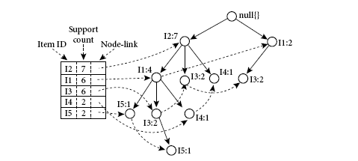
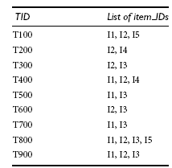
FP-growth tree
Transactional data
FP-growth tree
Steps:
1: derive the set of frequent items (1-itemsets) and their support counts (frequencies). Min_support_count=2.
2. Sort them in order of descending support count.
Thus, we have L =I2:7, I1:6, I3:6,I4: 2, I5: 2.

Slide 50
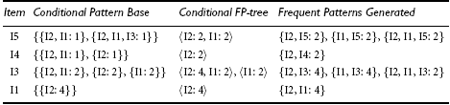
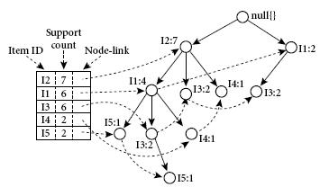
Mining the FP-tree by creating conditional
(sub-)pattern bases.
Steps:
1. Start from each frequent length-1 pattern (initial suffix pattern), construct its conditional pattern base (a “subdatabase,”which consists of the set of prefix paths in the FP-tree co-occurring with the suffix pattern), then construct its (conditional) FP-tree

Slide 51
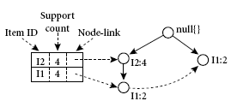
How to find conditional FP tree for I3
I3’s conditional pattern base is I2, I1: 2, I2: 2, I1: 2.
Its conditional FP-tree has two branches, I2: 4, I1: 2 and I1: 2

Slide 52
Mining Frequent Patterns With FP-trees
Idea: Frequent pattern growth
  Recursively grow frequent patterns by pattern and database partition
Method
  For each frequent item, construct its conditional pattern-base, and then its conditional FP-tree
  Repeat the process on each newly created conditional FP-tree
  Until the resulting FP-tree is empty, or it contains only one path—single path will generate all the combinations of its sub-paths, each of which is a frequent pattern

Slide 53
FP-Growth Algorithm
It allows frequent itemset discovery without candidate itemset generation.
Two step approach:
Step 1: Build a compact data structure called the FP-tree
  Built using 2 passes over the data-set.
Step 2: Extracts frequent itemsets directly from the FP-tree
  Traversal through FP-Tree

Slide 54
FP-Tree is constructed using
2 passes over the data-set
Pass 1:
  Scan data and find support for each item.
  Discard infrequent items.
  Sort frequent items in decreasing order based on their support.
  Use this order when building the FP-Tree, so common prefixes can be shared.
Step 1: FP-Tree Construction (Example)
Pass 2: construct the FP-Tree
  Read transactions one at a time.
  Create nodes for each item of this transaction.
  Set counts of each item (i.e., node) to 1.
  Read next transaction. Note that if transaction 1 and 2 share an item , the paths may be disjoint as they don't share a common prefix.
  Add the link between the item.
  If it shares common prefix item, say a, with transaction 1 so the path for transaction 1 and 3 will overlap and the frequency count for node a will be incremented by 1.
Continue until all transactions are mapped to a path in the FP-tree.

Slide 55
1. The FP-tree construction :
Scan the transaction database D once.
  Collect frequent items, and their support counts.
  Sort list of frequent items in support count descending order: L
Create the root of an FP-tree, and label it as “null.” For each transaction Trans in D do the following.
  Select and sort the frequent items in Trans according to the order of L.

Slide 56
2. The FP-tree Mining
procedure FP growth(Tree, a)
  (1) if Tree contains a single path P then
  (2) for each combination (denoted as β) of the nodes in the path P
  (3) generate pattern β U α with support count = minimum support count of nodes in β;
  (4) else for each ai in the header of Tree f
  (5) generate pattern β = ai U α with support = ai.support;
  (6) construct β’s conditional pattern base and then β’s conditional FP tree Treeβ;
  (7) if Treeβ <> Φ then
  (8) call FP growth(Treeβ, β); g

Slide 57
Advantages of FP-Growth
Divide-and-conquer:
  decompose both the mining task and DB according to the frequent patterns obtained so far
  leads to focused search of smaller databases
Other factors
  no candidate generation, no candidate test
  compressed database: FP-tree structure
  no repeated scan of entire database
  basic ops—counting local freq items and building sub FP-tree, no pattern search and matching

Slide 58
Closed Patterns and Max-Patterns
A long pattern contains a combinatorial number of sub-patterns
Solution: Mine closed patterns and max-patterns instead
An itemset X is closed if X is frequent and there exists no super-pattern Y כ X, with the same support as X:
A closed pattern -> frequent pattern (meets min_sup criteria). Also, all super-patterns of a closed pattern are less frequent than the closed pattern.
Ex: a) Items: a,b,c Patterns: {a,b}: 2, {a,b,c}:2 ➔ {a,b} is frequent but not closed. | 3 Items: x,y,z Patterns: {x,y}:3, {xyz}:2 ➔ {xy} is a closed pattern
Min_sup:2
Sup_Count(subset) > Sup_Count(Superset)→ subset is closed | both frequent

Slide 59
Closed Patterns and Max-Patterns
An itemset X is a max-pattern if X is frequent and there exists no frequent super-pattern Y כ X .
A max pattern → frequent pattern (meets min_sup criteria like closed pattern). But, Unlike closed pattern, all super-patterns of a max pattern are NOT frequent patterns.
Min_sup:2
Ex: a) Items: a,b,c Patterns: {a,b}: 3, {a,b,c}:2 ➔ {a,b} is frequent but not Max Pattern. | 3 Items: x,y,z Patterns: {x,y}:3, {xyz}:1 ➔ {xy} is a Max pattern
Sup_Count(subset) > Sup_Count(Superset)→ subset is max pattern |
subset is frequent
superset is NOT frequent
Sup_Count(subset) > Sup_Count(Superset)→ subset is closed | both frequent

Slide 60
ECLAT: Mining by Exploring Vertical Data Format
Vertical format: t(AB) = {T₁₁, T₂₅, …}
  tid-list: list of trans.-ids containing an itemset
Deriving frequent patterns based on vertical intersections
  t(X) = t(Y): X and Y always happen together
  t(X) ⊂ t(Y): transaction having X always has Y
Using diffset to accelerate mining
  Only keep track of differences of tids
  t(X) = {T₁, T₂, T₃}, t(XY) = {T₁, T₃}
  Diffset (XY, X) = {T₂}
Eclat (Zaki et al. @KDD’97)
Mining Closed patterns using vertical format: CHARM (Zaki & Hsiao@SDM’02)

Slide 61
Mining Frequent, Associations and Correlations:
Basic concepts,
Frequent Item set mining methods,
Mining multilevel association rules from Transaction Databases,
Mining Multidimensional association rules from Relational databases and Data Warehouses,
From Association Mining to Correlation Analysis,
Constraint-Based Association Mining.

Slide 62
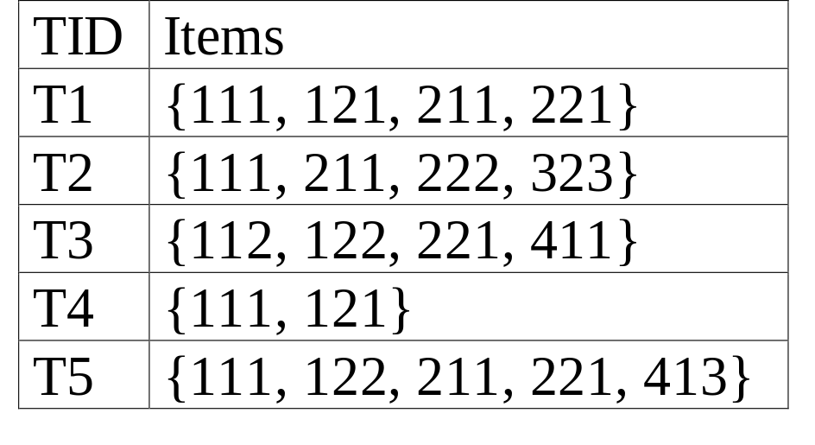
Multiple-Level Association Rules
Food
Items often form hierarchy. (Concept Hierarchy)
Items at the lower level are expected to have lower support.
Rules regarding itemsets at
appropriate levels could be quite useful.
Transaction database can be encoded based on dimensions and levels
We can explore shared multi-level mining
milk
bread
skim
2%
wheat
white
Fraser
Sunset

Slide 63
Approaches to Mining Multi-level ARs
Uniform Support vs. Reduced Support
Uniform Support: the same minimum support for all levels
  + One minimum support threshold. No need to examine itemsets containing any item whose ancestors do not have minimum support.
  – Lower level items do not occur as frequently. If support threshold
    too high ⇒ miss low level associations
    too low ⇒ generate too many high level associations
Reduced Support: reduced minimum support at lower levels
  There are 4 search strategies:
    Level-by-level independent
    Level-cross filtering by single item
    Level-cross filtering by k-itemset
    Controlled level-cross filtering by single item

Slide 64
Uniform Support
1. Level-by-level independent (Relaxed)
Multi-level mining with uniform support
Level 1
min_sup = 5%
Milk
[support = 10%]
Level 2
min_sup = 5%
2% Milk
[support = 6%]
Skim Milk
[support = 4%]

Slide 65
Reduced Support
Multi-level mining with reduced support
Level 1
min_sup = 5%
Milk
[support = 10%]
Level 2
min_sup = 3%
2% Milk
[support = 6%]
Skim Milk
[support = 4%]
Back

Slide 66
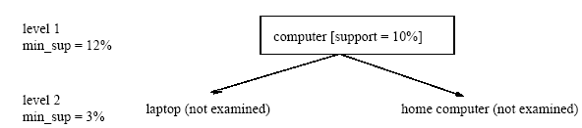
Reduced Support:
Each node is examined, regardless of whether or not its parent node is found to be frequent.
2. level-cross filtering by single item (Conditional Compromise between 2 extremes)
An item at the i-th level is examined iff its parent node at the (i-1)th level is frequent. Sets a level passage threshold for every level. Allows the inspection of lower abstractions even if its ancestor fails to satisfy min_sup threshold.
If a node is frequent, its children will be examined; otherwise, its descendents are pruned from the search.

Slide 67
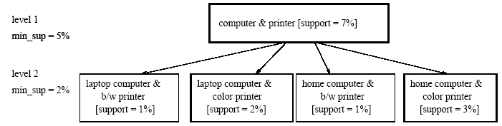
3. level-cross filtering by k-itemset (Very Strong)
A k-itemset at the i-th level is examined iff its corresponding parent k-itemset at the (i-1)th level is frequent.
  Ex: the 2-itemset {computer, printer} is frequent
  Therefore the nodes {laptop computer, b/w printer},
    {laptop computer, color printer}, {home computer, b/w printer} and {home computer, color printer}" are examined.

Slide 68
methods comparision
level-by-level independent : very relaxed
  it may lead to examining numerous infrequent items at low levels,
level-cross filtering by k-itemset : Very Strong
  It allows the mining system to examine only the children of frequent k-itemsets. This restriction is very strong in that there usually are not many k-itemsets (especially when k > 2) which, when combined, are also frequent. Hence, many valuable patterns may be filtered out using this approach.
level-cross filtering by single item : compromise between the two extremes.
  But this may miss associations between low level items that are frequent based on a reduced min_sup, but whose ancestors do not satisfy minimum support (since the support thresholds at each level can be different).

Slide 69
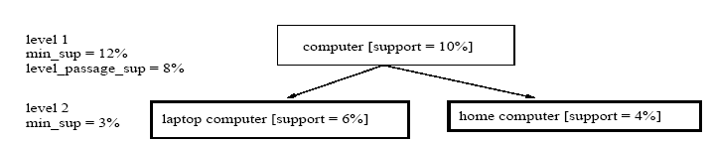
4. Controlled level-cross filtering by single item strategy
A threshold, called the level passage threshold, can be set up for passing down relatively frequent items (called subfrequent items) to lower levels.
i.e., this method allows the children of items that do not satisfy the minimum support threshold to be examined if these items satisfy the level passage threshold.

Slide 70
Multi-level Association: Redundancy Filtering
Some rules may be redundant due to “ancestor” relationships between items.
Example
  milk ⇒ wheat bread [support = 8%, confidence = 70%]
  2% milk ⇒ wheat bread [support = 2%, confidence = 72%]
We say the first rule is an ancestor of the second rule.
A rule is redundant if its support is close to the “expected” value, based on the rule’s ancestor.

Slide 71
Mining Frequent, Associations and Correlations:
Basic concepts,
Frequent Item set mining methods,
Mining multilevel association rules from Transaction Databases,
Mining Multidimensional association rules from Relational databases and Data Warehouses,
From Association Mining to Correlation Analysis,
Constraint-Based Association Mining.

Slide 72
Mining Multi-Dimensional Association
Single-dimensional rules:
    buys(X, “milk”) ⇒ buys(X, “bread”)
Multi-dimensional rules: ≥ 2 dimensions or predicates
  Inter-dimension assoc. rules (no repeated predicates)
    age(X,”19-25”) ∧ occupation(X,“student”) ⇒ buys(X, “coke”)
  hybrid-dimension assoc. rules (repeated predicates)
    age(X,”19-25”) ∧ buys(X, “popcorn”) ⇒ buys(X, “coke”)
Categorical Attributes: finite number of possible values, no ordering among values—data cube approach
Quantitative Attributes: Numeric, implicit ordering among values—discretization, clustering, and gradient approaches

Slide 73
Mining Frequent, Associations and Correlations:
Basic concepts,
Frequent Item set mining methods,
Mining multilevel association rules from Transaction Databases,
Mining Multidimensional association rules from Relational databases and Data Warehouses,
From Association Mining to Correlation Analysis,
Constraint-Based Association Mining.

Slide 74



Interestingness Measure: Correlations (Lift)
play basketball ⇒ eat cereal [40%, 66.7%] is misleading
  The overall % of students eating cereal is 75% > 66.7%.
play basketball ⇒ not eat cereal [20%, 33.3%] is more accurate, although with lower support and confidence
Measure of dependent/correlated events: lift
 | Basketball | Not basketball | Sum (row)
Cereal | 2000 | 1750 | 3750
Not cereal | 1000 | 250 | 1250
Sum(col.) | 3000 | 2000 | 5000

Slide 75

Are lift and χ² Good Measures of Correlation?
“Buy walnuts ⇒ buy milk [1%, 80%]” is misleading if 85% of customers buy milk
Support and confidence are not good to indicate correlations
Over 20 interestingness measures have been proposed (see Tan, Kumar, Sritastava @KDD’02)
Which are good ones?

Slide 76

Null-Invariant Measures

Slide 77


Comparison of Interestingness Measures
Null-(transaction) invariance is crucial for correlation analysis
Lift and χ² are not null-invariant
5 null-invariant measures
 | Milk | No Milk | Sum (row)
Coffee | m, c | ~m, c | c
No Coffee | m, ~c | ~m, ~c | ~c
Sum(col.) | m | ~m | Σ
Null-transactions w.r.t. m and c
Kulczynski measure (1927)
Null-invariant
Data Mining: Concepts and Techniques
Subtle: They disagree

Slide 78

Analysis of DBLP Coauthor Relationships
Recent DB conferences, removing balanced associations, low sup, etc.
Advisor-advisee relation: Kulc: high, coherence: low, cosine: middle
Tianyi Wu, Yuguo Chen and Jiawei Han, “Association Mining in Large Databases: A Re-Examination of Its Measures”, Proc. 2007 Int. Conf. Principles and Practice of Knowledge Discovery in Databases (PKDD'07), Sept. 2007

Slide 79


Which Null-Invariant Measure Is Better?
IR (Imbalance Ratio): measure the imbalance of two itemsets A and B in rule implications
Kulczynski and Imbalance Ratio (IR) together present a clear picture for all the three datasets D₄ through D₆
  D₄ is balanced & neutral
  D₅ is imbalanced & neutral
  D₆ is very imbalanced & neutral

Slide 80
Mining Frequent, Associations and Correlations:
Basic concepts,
Frequent Item set mining methods,
Mining multilevel association rules from Transaction Databases,
Mining Multidimensional association rules from Relational databases and Data Warehouses,
From Association Mining to Correlation Analysis,
Constraint-Based Association Mining.

Slide 81
Constraint-Based Frequent Pattern Mining
Pattern space pruning constraints
  Anti-monotonic: If constraint c is violated, its further mining can be terminated
  Monotonic: If c is satisfied, no need to check c again
  Succinct: c must be satisfied, so one can start with the data sets satisfying c
  Convertible: c is not monotonic nor anti-monotonic, but it can be converted into it if items in the transaction can be properly ordered
Data space pruning constraint
  Data succinct: Data space can be pruned at the initial pattern mining process
  Data anti-monotonic: If a transaction t does not satisfy c, t can be pruned from its further mining

Slide 82
Pattern Space Pruning with Anti-Monotonicity Constraints
TDB (min_sup=2)
A constraint C is anti-monotone if the super pattern satisfies C, all of its sub-patterns do so too
In other words, anti-monotonicity: If an itemset S violates the constraint, so does any of its superset
Ex. 1. sum(S.price) ≤ v is anti-monotone
Ex. 2. range(S.profit) ≤ 15 is anti-monotone
  Itemset ab violates C
  So does every superset of ab
Ex. 3. sum(S.Price) ≥ v is not anti-monotone
Ex. 4. support count is anti-monotone: core property used in Apriori
TID | Transaction
10 | a, b, c, d, f
20 | b, c, d, f, g, h
30 | a, c, d, e, f
40 | c, e, f, g
Item | Profit
a | 40
b | 0
c | -20
d | 10
e | -30
f | 30
g | 20
h | -10

Slide 83
Pattern Space Pruning with Monotonicity Constraints
TDB (min_sup=2)
A constraint C is monotone if the pattern satisfies C, we do not need to check C in subsequent mining
Alternatively, monotonicity: If an itemset S satisfies the constraint, so does any of its superset
Ex. 1. sum(S.Price) ≥ v is monotone
Ex. 2. min(S.Price) ≤ v is monotone
Ex. 3. C: range(S.profit) ≥ 15
  Itemset ab satisfies C
  So does every superset of ab
TID | Transaction
10 | a, b, c, d, f
20 | b, c, d, f, g, h
30 | a, c, d, e, f
40 | c, e, f, g
Item | Profit
a | 40
b | 0
c | -20
d | 10
e | -30
f | 30
g | 20
h | -10

Slide 84
Data Space Pruning with Data Anti-monotonicity
TDB (min_sup=2)
A constraint c is data anti-monotone if for a pattern p cannot satisfy a transaction t under c, p’s superset cannot satisfy t under c either
The key for data anti-monotone is recursive data reduction
Ex. 1. sum(S.Price) ≥ v is data anti-monotone
Ex. 2. min(S.Price) ≤ v is data anti-monotone
Ex. 3. C: range(S.profit) ≥ 25 is data anti-monotone
  Itemset {b, c}’s projected DB:
    T10’: {d, f, h}, T20’: {d, f, g, h}, T30’: {d, f, g}
  since C cannot satisfy T10’, T10’ can be pruned
TID | Transaction
10 | a, b, c, d, f, h
20 | b, c, d, f, g, h
30 | b, c, d, f, g
40 | c, e, f, g
Item | Profit
a | 40
b | 0
c | -20
d | -15
e | -30
f | -10
g | 20
h | -5

Slide 85
Pattern Space Pruning with Succinctness
Succinctness:
  Given A_{1,} the set of items satisfying a succinctness constraint C, then any set S satisfying C is based on A₁ , i.e., S contains a subset belonging to A₁
  Idea: Without looking at the transaction database, whether an itemset S satisfies constraint C can be determined based on the selection of items
  min(S.Price) ≤ v is succinct
  sum(S.Price) ≥ v is not succinct
Optimization: If C is succinct, C is pre-counting pushable

Slide 86








Naïve Algorithm: Apriori + Constraint
Database D
L₁
C₁
Scan D
C₂
C₂
L₂
Scan D
C₃
Scan D
L₃
Constraint:
Sum{S.price} < 5

Slide 87
Constrained Apriori : Push a Succinct Constraint Deep
Database D
L₁
C₁
Scan D
C₂
C₂
L₂
Scan D
not immediately
to be used
C₃
Scan D
L₃
Constraint:
min{S.price } <= 1

Slide 88
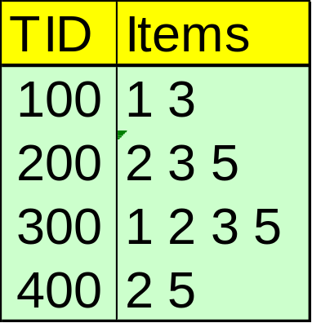
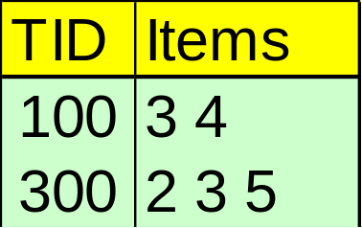
Constrained FP-Growth: Push a Succinct Constraint Deep
FP-Tree
Remove
infrequent
length 1
1-Projected DB
No Need to project on 2, 3, or 5
Constraint:
min{S.price } <= 1

Slide 89
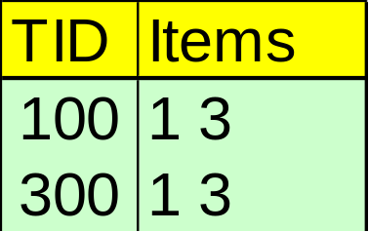
Constrained FP-Growth: Push a Data Anti-monotonic Constraint Deep
Remove from data
FP-Tree
Single branch, we are done
Constraint:
min{S.price } <= 1

Slide 90
Constrained FP-Growth: Push a Data Anti-monotonic Constraint Deep
TID | Transaction
10 | a, b, c, d, f, h
20 | b, c, d, f, g, h
30 | b, c, d, f, g
40 | a, c, e, f, g
TID | Transaction
10 | a, b, c, d, f, h
20 | b, c, d, f, g, h
30 | b, c, d, f, g
40 | a, c, e, f, g
FP-Tree
Item | Profit
a | 40
b | 0
c | -20
d | -15
e | -30
f | -10
g | 20
h | -5
B-Projected DB
Recursive
Data
Pruning
TID | Transaction
10 | a, c, d, f, h
20 | c, d, f, g, h
30 | c, d, f, g
B
FP-Tree
  Single branch:
    bcdfg: 2
Constraint:
range{S.price } > 25
min_sup >= 2

Slide 91
Convertible Constraints: Ordering Data in Transactions
TDB (min_sup=2)
Convert tough constraints into anti-monotone or monotone by properly ordering items
Examine C: avg(S.profit) ≥ 25
  Order items in value-descending order
    <a, f, g, d, b, h, c, e>
  If an itemset afb violates C
    So does afbh, afb*
    It becomes anti-monotone!
TID | Transaction
10 | a, b, c, d, f
20 | b, c, d, f, g, h
30 | a, c, d, e, f
40 | c, e, f, g
Item | Profit
a | 40
b | 0
c | -20
d | 10
e | -30
f | 30
g | 20
h | -10

Slide 92
Strongly Convertible Constraints
avg(X) ≥ 25 is convertible anti-monotone w.r.t. item value descending order R: <a, f, g, d, b, h, c, e>
  If an itemset af violates a constraint C, so does every itemset with af as prefix, such as afd
avg(X) ≥ 25 is convertible monotone w.r.t. item value ascending order R⁻¹: <e, c, h, b, d, g, f, a>
  If an itemset d satisfies a constraint C, so does itemsets df and dfa, which having d as a prefix
Thus, avg(X) ≥ 25 is strongly convertible
Item | Profit
a | 40
b | 0
c | -20
d | 10
e | -30
f | 30
g | 20
h | -10

Slide 93
Can Apriori Handle Convertible Constraints?
A convertible, not monotone nor anti-monotone nor succinct constraint cannot be pushed deep into the an Apriori mining algorithm
  Within the level wise framework, no direct pruning based on the constraint can be made
  Itemset df violates constraint C: avg(X) >= 25
  Since adf satisfies C, Apriori needs df to assemble adf, df cannot be pruned
But it can be pushed into frequent-pattern growth framework!
Item | Value
a | 40
b | 0
c | -20
d | 10
e | -30
f | 30
g | 20
h | -10

Slide 94
Pattern Space Pruning w. Convertible Constraints
C: avg(X) >= 25, min_sup=2
List items in every transaction in value descending order R: <a, f, g, d, b, h, c, e>
  C is convertible anti-monotone w.r.t. R
Scan TDB once
  remove infrequent items
    Item h is dropped
  Itemsets a and f are good, …
Projection-based mining
  Imposing an appropriate order on item projection
  Many tough constraints can be converted into (anti)-monotone
Item | Value
a | 40
f | 30
g | 20
d | 10
b | 0
h | -10
c | -20
e | -30
TDB (min_sup=2)
TID | Transaction
10 | a, f, d, b, c
20 | f, g, d, b, c
30 | a, f, d, c, e
40 | f, g, h, c, e

Slide 95
Handling Multiple Constraints
Different constraints may require different or even conflicting item-ordering
If there exists an order R s.t. both C₁ and C₂ are convertible w.r.t. R, then there is no conflict between the two convertible constraints
If there exists conflict on order of items
  Try to satisfy one constraint first
  Then using the order for the other constraint to mine frequent itemsets in the corresponding projected database

Slide 96
What Constraints Are Convertible?
Constraint | Convertible anti-monotone | Convertible monotone | Strongly convertible
avg(S) ≤ , ≥ v | Yes | Yes | Yes
median(S) ≤ , ≥ v | Yes | Yes | Yes
sum(S) ≤ v (items could be of any value, v ≥ 0) | Yes | No | No
sum(S) ≤ v (items could be of any value, v ≤ 0) | No | Yes | No
sum(S) ≥ v (items could be of any value, v ≥ 0) | No | Yes | No
sum(S) ≥ v (items could be of any value, v ≤ 0) | Yes | No | No
……

Slide 97
Constraint-Based Mining — A General Picture
Constraint | Anti-monotone | Monotone | Succinct
v ∈ S | no | yes | yes
S ⊇ V | no | yes | yes
S ⊆ V | yes | no | yes
min(S) ≤ v | no | yes | yes
min(S) ≥ v | yes | no | yes
max(S) ≤ v | yes | no | yes
max(S) ≥ v | no | yes | yes
count(S) ≤ v | yes | no | weakly
count(S) ≥ v | no | yes | weakly
sum(S) ≤ v ( a ∈ S, a ≥ 0 ) | yes | no | no
sum(S) ≥ v ( a ∈ S, a ≥ 0 ) | no | yes | no
range(S) ≤ v | yes | no | no
range(S) ≥ v | no | yes | no
avg(S) θ v, θ ∈ { =, ≤, ≥ } | convertible | convertible | no
support(S) ≥ ξ | yes | no | no
support(S) ≤ ξ | no | yes | no

Slide 98
Examples for Practice

Slide 99
Construct FP-tree from a Transaction Database
TID Items bought (ordered) frequent items
100 {f, a, c, d, g, i, m, p} {f, c, a, m, p}
200 {a, b, c, f, l, m, o} {f, c, a, b, m}
300 {b, f, h, j, o, w} {f, b}
400 {b, c, k, s, p} {c, b, p}
500 {a, f, c, e, l, p, m, n} {f, c, a, m, p}
min_support = 3
Scan DB once, find frequent 1-itemset (single item pattern)
Sort frequent items in frequency descending order, f-list
Scan DB again, construct FP-tree
{}
Header Table
Item frequency head
f 4
c 4
a 3
b 3
m 3
p 3
f:4
c:1
c:3
b:1
b:1
a:3
p:1
m:2
b:1
F-list=f-c-a-b-m-p
p:2
m:1

Slide 100
Find Patterns Having P From P-conditional Database
Starting at the frequent item header table in the FP-tree
Traverse the FP-tree by following the link of each frequent item p
Accumulate all of transformed prefix paths of item p to form p’s conditional pattern base
{}
Header Table
Item frequency head
f 4
c 4
a 3
b 3
m 3
p 3
f:4
c:1
Conditional pattern bases
item cond. pattern base
c f:3
a fc:3
b fca:1, f:1, c:1
m fca:2, fcab:1
p fcam:2, cb:1
c:3
b:1
b:1
a:3
p:1
m:2
b:1
p:2
m:1

Slide 101
From Conditional Pattern-bases to Conditional FP-trees
For each pattern-base
  Accumulate the count for each item in the base
  Construct the FP-tree for the frequent items of the pattern base
m-conditional pattern base:
  fca:2, fcab:1
{}
Header Table
Item frequency head
f 4
c 4
a 3
b 3
m 3
p 3
f:4
c:1
All frequent patterns relate to m
m,
fm, cm, am,
fcm, fam, cam,
fcam
{}
c:3
b:1
b:1

f:3

a:3
p:1
m:2
b:1
c:3
p:2
m:1
a:3
m-conditional FP-tree

Slide 102
Mining Frequent Patterns by Creating Conditional Pattern-Bases
Item
Conditional pattern-base
Conditional FP-tree
p
{(fcam:2), (cb:1)}
{(c:3)}|p
m
{(fca:2), (fcab:1)}
{(f:3, c:3, a:3)}|m
b
{(fca:1), (f:1), (c:1)}
Empty
a
{(fc:3)}
{(f:3, c:3)}|a
c
{(f:3)}
{(f:3)}|c
f
Empty
Empty

Slide 103
An example
  t1: Beef, Chicken, Milk
  t2: Beef, Cheese
  t3: Cheese, Boots
  t4: Beef, Chicken, Cheese
  t5: Beef, Chicken, Clothes, Cheese, Milk
  t6: Chicken, Clothes, Milk
  t7: Chicken, Milk, Clothes
Transaction data
Assume:
minsup = 30%
minconf = 80%
An example frequent itemset:
{Chicken, Clothes, Milk} [sup = 3/7]
Association rules from the itemset:
Clothes → Milk, Chicken [sup = 3/7, conf = 3/3]
… …
Clothes, Chicken → Milk, [sup = 3/7, conf = 3/3]
CS583, Bing Liu, UIC

